Slide 1
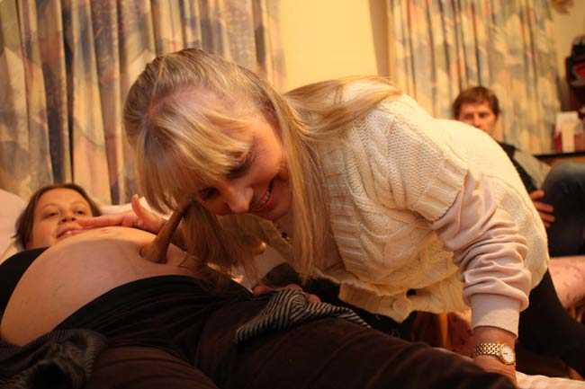
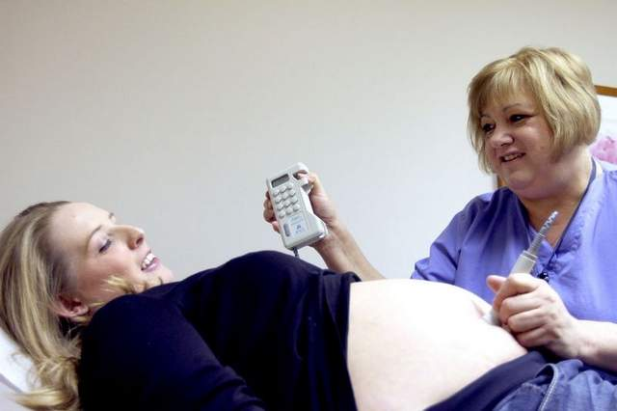
Monitoring Baby’s Health
When Medical Concern is ..
Intermittent
LOW

Slide 2
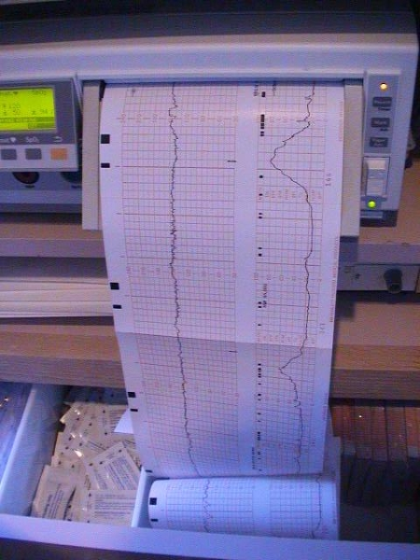
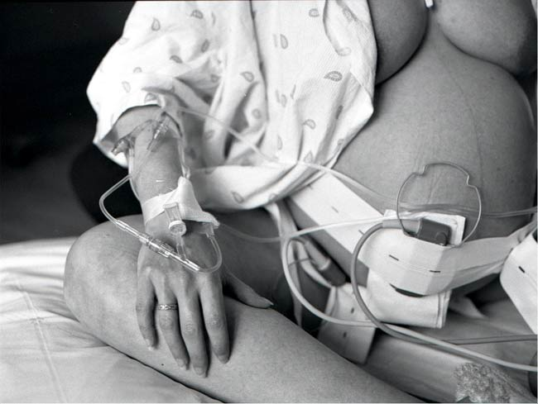
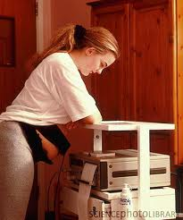
Monitoring Baby’s Health
When Medical Concern is ..
Continuous
External Monitoring
Moderate

Slide 3
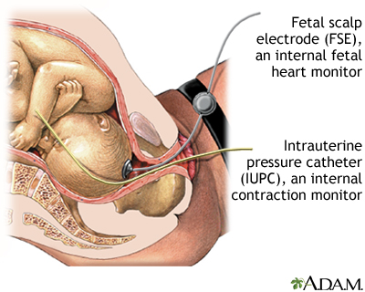
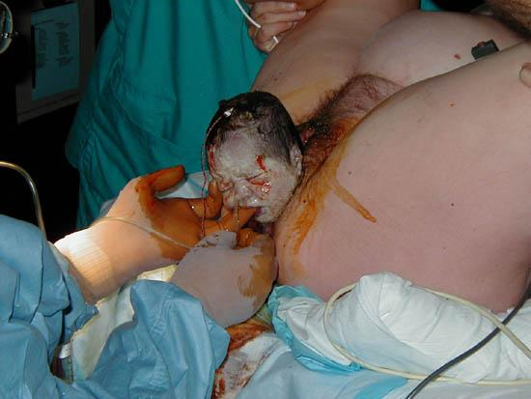
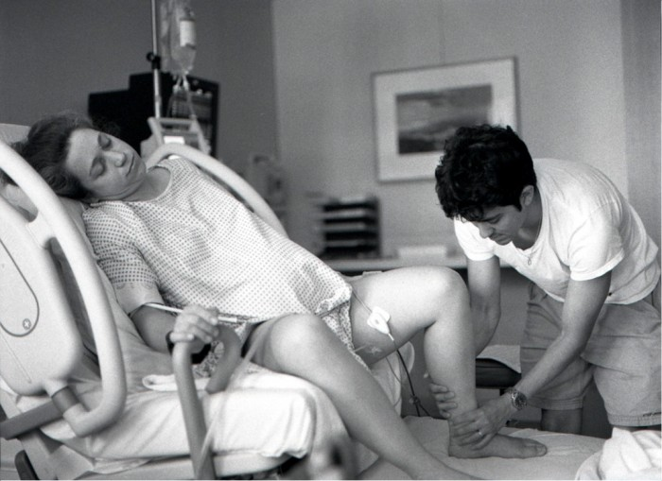
Monitoring Baby’s Health
When Medical Concern is ..
Continuous
Internal Monitoring
High

