Slide 1
Session 12
The Current State of
Maternity Care

Slide 2
Notes:
Statistically, how does the health of US mothers and babies stack up against similarly developed countries

Slide 3
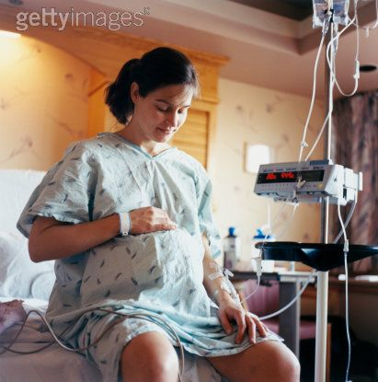
Notes:
What maternity care looks like for the average woman in during labor and birth

Slide 4
Notes:
What and who are behind the trends of maternity care today.
Doctors?

Slide 5
Notes:
What and who are behind the trends of maternity care today.
Lawyers?

Slide 6
Notes:
Consumers?

Slide 7
Reducing Infant Mortality

Slide 8
Current Trends in the United States
Rate of Induced Birth
Year | Rate
1989 | 9%
1997 | 18%
2001 | 20%
2003 | 27%
2006 | Estimated to be as high as 40%
200% increase since 1989
Notes:
Induction rates: Up.

Slide 9
Current Trends in the United States
Epidural Rates in 2005
Race/Ethnicity | Rate
White | 71%
Black | 65%
Hispanic | 58%
All Women | 67%
Most women have epidurals
Notes:
Epidural rates: epidurals are the norm. 86-90% in urban areas.

Slide 10
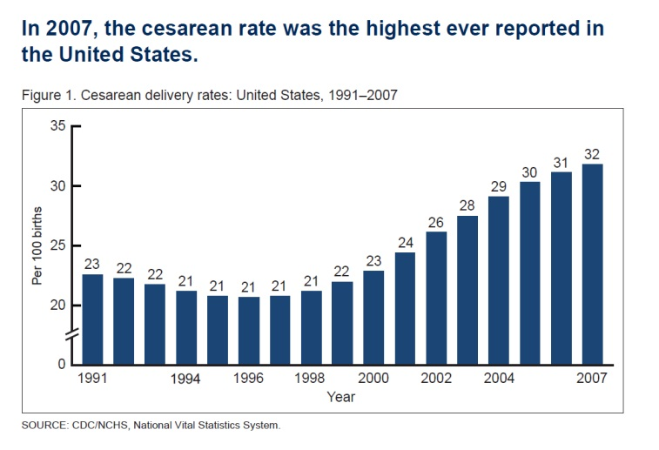
Current Trends in the United States
32% Cesarean Birth Rate
Notes:
Cesarean rates: More women are having their babies via cesarean than at any other time in history. Do 40 year old women understand they have an essentially 50% likelihood of a cesarean birth?

Slide 11
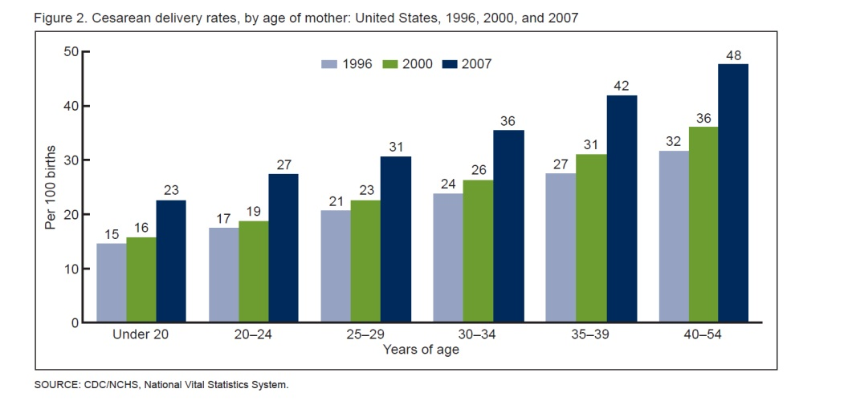
Current Trends in the United States
Notes:
Cesarean rates: More women are having their babies via cesarean than at any other time in history.
Do 40 year old women understand they have an essentially 50% likelihood of a cesarean birth?

Slide 12
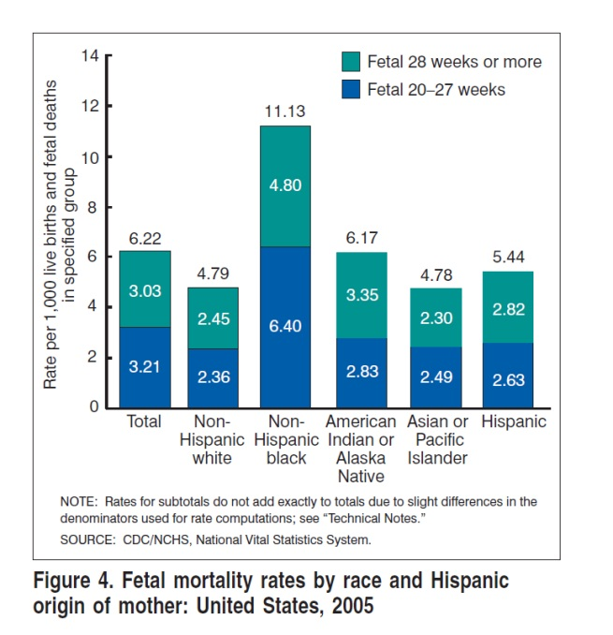
Current Trends in the United States
Notes:
Fetal mortality rates: Notice disparity in groups where there has been and is currently poverty, social injustice (lack of education and opportunities).

Slide 13
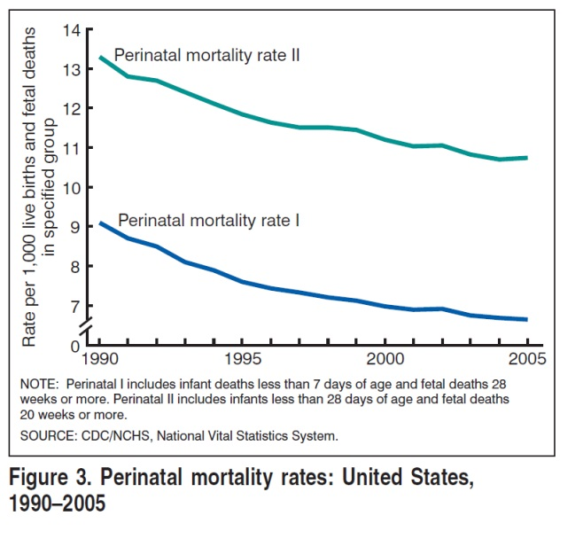
Current Trends in the United States
Notes:
Perinatal birth rate: Dropping since the 40’s, although stagnant for the last several. What does that do to US women’s perceptions of fetal death rate, stillbirth rate? Do we remember what it was like to have some babies “not make it”. Are we clinging to over-inflated intervention rates in order to “save all babies”?
The World Health Organization defines perinatal mortality as the "number of stillbirths and deaths in the first week of life per 1,000 live births",^{[1]} but other definitions have been used

Slide 14
Perinatal Mortality Rate from 1940s to 2000s
Year | Rate
1940s | 45.0
1950s | 32.2
1960s | 28.6
1970s | 23.0
1980s | 13.2
1990 | 9.2
1995 | 7.6
2000 | 7.0
2001 | 6.9
2002 | 6.9
2003 | 6.8
2004 | 6.7
2006 | 6.6
Notes:
Perinatal birth rate: Dropping since the 40’s, although stagnant for the last several. What does that do to US women’s perceptions of fetal death rate, stillbirth rate? Do we remember what it was like to have some babies “not make it”. Are we clinging to over-inflated intervention rates in order to “save all babies”?
The World Health Organization defines perinatal mortality as the "number of stillbirths and deaths in the first week of life per 1,000 live births",^{[1]} but other definitions have been used

Slide 15
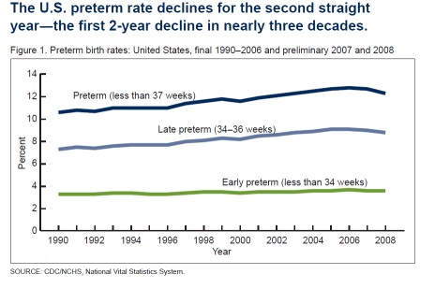
Current Trends in the United States
Prematurity? A Glimmer of hope?
Notes:
Late premature birth: After yearly increases since the 1990s, we’ve had two years of decrease. Why might this be? March of Dimes campaign “no induction” before 39 weeks?

Slide 16
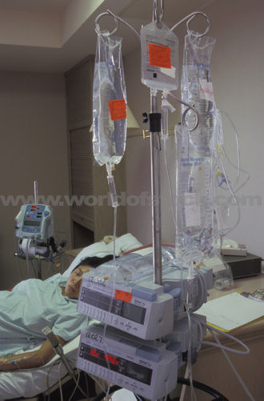
What to Expect?
41% Induction
71% CEFM
65% AROM
76%-90% Pain meds
85% No Food
76% No Mobility
60% Vaginal Birth
(2006 Listening to Mothers II)
Notes:
If we took a snapshot of birth now, we’d see a lot of medical tools used and little participation from mother.
And birth looks a lot like this
Coin flip before vaginal birth.

Slide 17
Notes:
As technology increases and participation decreases, look what is happening to cesarean & VBAC trends.

Slide 18
What’s Behind This Trend?
Political and financial interests?
Cultural influences?
Legal and liability issues?

Slide 19
… on how you see birth.
Maternity care depends …

Slide 20
Physiologic
Psychologic
“Holistic”
Industrial/
Mechanized
“Technocratic”
Notes:
Trust Birth: Women’s bodies have their own wisdom, and a system of birth refined over 100,000 generations is not so easily overpowered. – Sarah Buckly, MD
Reliability: Putting so many mothers through (cesarean) surgery is hardly a cause for celebration. But, our deep-seated desire to limit risk to babies is the biggest force behind its prevalence. It is the price exacted by the reliability we aspire to. – Atul Gawande, MD

Slide 21
Physiological-Psychologic
Optimal health
Born the way nature intended
Industrial-Mechanized
Reliability
Predictability
Notes:
Holistic Model: Optimal health and emotional experience for mother and baby. Born the way nature intended.
Technocratic: Reliability and predictability of outcome is paramount. Live baby, live mother every time.

Slide 22
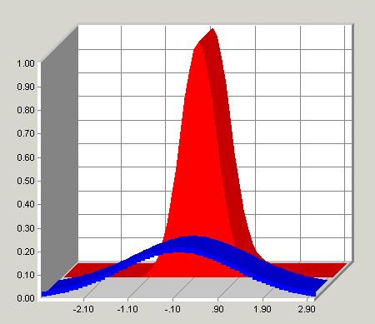
Breech
Presentation
Physiological-Psychologic
Wide
Inclusive
Industrial-Mechanized
Narrow
Selective

Slide 23
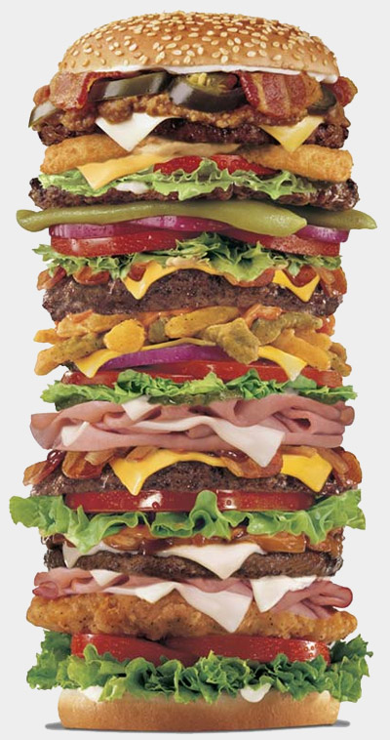
What Can You Get?
Physiological-Psychologic
Industrial-Mechanized
Notes:
Craft: We do it your way. Room for individual variation and desires.
Industrial Assembly line production is the proven, bet way to get the most reliable and predictable results.

Slide 24
Physiological-Psychologic
Risk is inherent to life
Parents presume risk
Industrial-Mechanized
Avoid risk at all costs
HCPs presume risk

Slide 25
Learning Tasks - 6 minutes
Think about the effects of current maternity care trends on women, families, babies and choices. Name two consequences of today’s current maternity care trends.
2. Think about your future clients. What kind of care will they likely receive?
PP IM
3. What maternity care providers are more likely to use the physiologic/pshychologic model?

Slide 26
Organizations working to Normalize Birth

Slide 27
THE END
Please fill out your evaluation for Session 12
THANK YOU!

